Slide 1
Micro-Segmentation
Aviatrix DCF for Intra VPC/VNET Micro-Segmentation

Slide 2
Micro-Segmentation Basics
Aviatrix Distributed Cloud Firewall enforces policy exactly where needed across the entire network.
Aviatrix DCF for Micro-Segmentation is for Intra and Inter VPC/VNET Segmentation
Characteristics:
Two components: Smart Groups & Policy (Rule)
Available for AWS and Azure
Fine-grained control, even for workloads in the same VPC/VNET
Orchestrating AWS Security Groups and Azure Network Security Group (NSG) for Intra-VPC or Intra-VNET segmentation

Slide 3
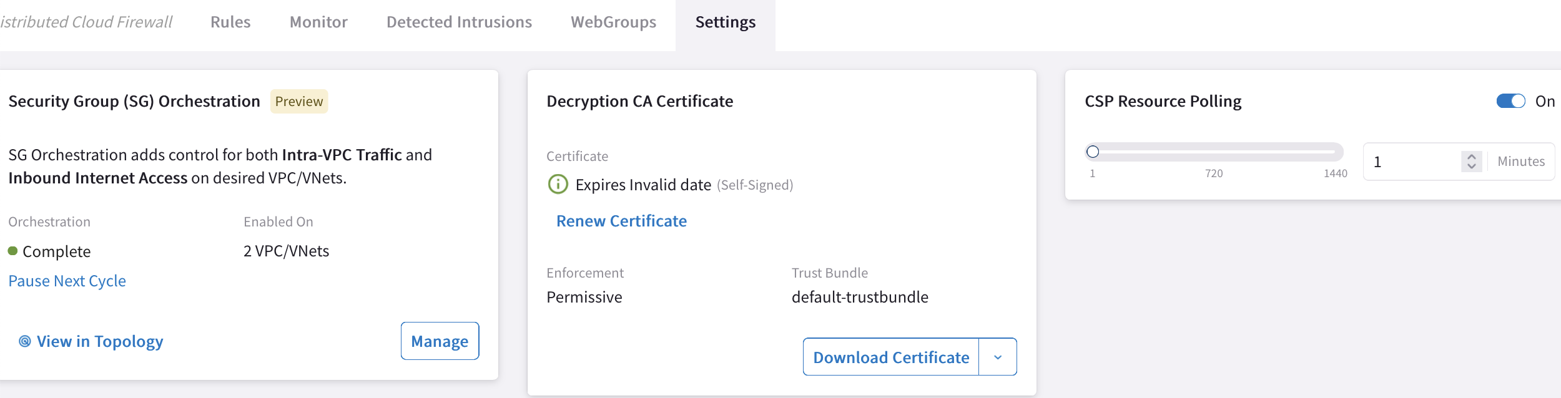

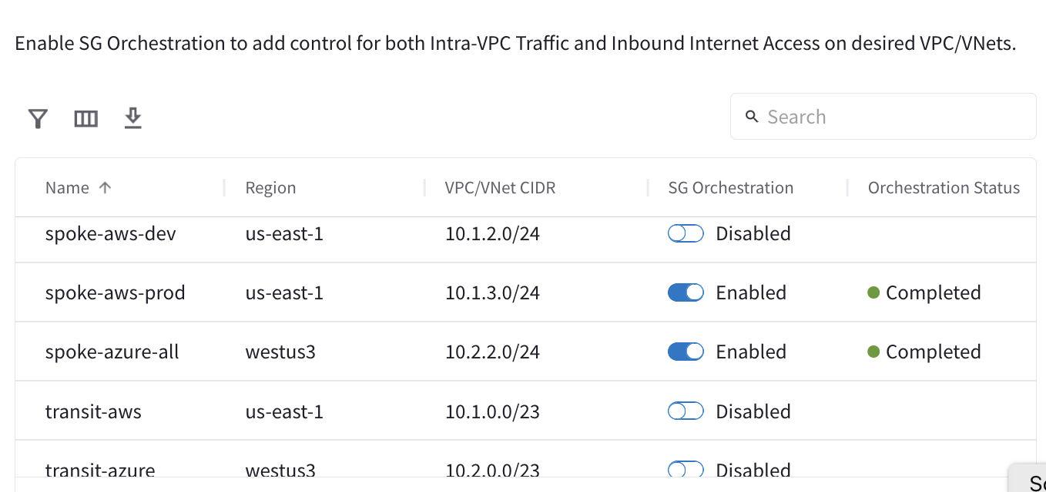



Intra VPC/VNET Distributed Firewalling (Micro-Segmentation)
VNet
SmartGroup #1
SmartGroup #2
Enable the feature on the concerned VPC/VNETS
Transit
Spoke

Slide 4
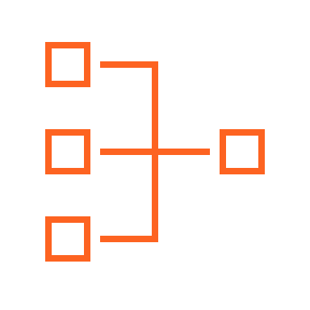

Network Segmentation & Micro-Segmentation Together
Network Domains
Smart Groups
LOB1
LOB2
Apache
Nginx
Scenario #1: Smart Group defined within a Network Segment
No connection policy between LOB1 and LOB2
Apache and Ngnix are part of two different Smart Groups and can communicate.
INTRA rule between Apache to Apache and only allow ICMP
Only Apache VMs can ping each other
Now, only Apache to Ngnix, only 443, is permitted.
Since implicit deny is there, only 443 is allowed.
Network Segmentation and Distributed Firewalling are NOT mutually exclusive.
VPC
VPC
VNet
VNet
Region 1
Region 2

Slide 5
Network Segmentation & Micro-Segmentation Together
Network Domains
Smart Groups
LOB1
LOB2
Apache
Nginx
VPC
VPC
VNet
VNet
Scenario #2: Smart Group stretched between two Network Domains
Network Segmentation takes precedence over the extent of a Smart Group
A rule between SGs can be defined for achieving the INTER-SMARTGROUP communication
Region 1
Region 2

Slide 6
Network Segmentation & Micro-Segmentation Together
Network Domains
Smart Groups
Network Domains
Smart Groups
LOB1
LOB2
Apache
Nginx
LOB1
LOB2
Apache
Nginx
VPC
VPC
VNet
VNet
VPC
VPC
VNet
VNet
A rule between SGs can be defined for achieving the INTER-SMARTGROUP communication
Region 1
Region 2
Region 1
Region 2
Scenario #1: Smart Group defined within a Network Segment
Network Segmentation and Distributed Firewalling are NOT mutually exclusive
Scenario #2: Smart Group stretched between two Network Domains
Network Segmentation takes precedence over the extent of a Smart Group

Slide 7


Aviatrix Certified Engineer (ACE)
COMMUNITY
https://aviatrix.com/ACE
https://community.aviatrix.com

Slide 8






Centralized Management
Aviatrix
Controller
Policy Orchestration
Aviatrix
CoPilot
Configuration and Visibility
Internet
FQDN Filtering
ALLOW *.github.com, updates.ubuntu.com
EXCEPT gist.github.com
deny all
Threat Prevention
Geo-Blocking
BLOCK Russia, North Korea
VPC
VPC
VPC
Distributed Perimeter Control

Slide 9

Aviatrix
Controller
Aviatrix
CoPilot
Internet
Internet
Aviatrix
Secure Egress
Gateways
Aviatrix Transit
Gateways
Aviatrix
Secure Egress
Gateways
AZ1
AZ2
AZ1
AZ2
Cloud
Workloads
Cloud
Workloads
App 1
App 2
Notes:
Visualization attaching an application to the Aviatrix Zero Trust Transit and adding East-West controls and micro-segmentation.

Slide 10







Reduce Cloud Costs, Improve Security, Non-Disruptive Deployment
Reduce Costs
Increase Security
Increase Security
Reduce Costs
$
$
NAT
Egress
NGFW
Replace CSP NAT Gateways
Reduce Cost Immediately
Add Distributed Cloud Firewall
for Egress
Add Full Distributed Cloud Firewall
with Secure Transit for E/W
Take a Bite Out of Firewall Costs
with Distributed Cloud Firewall
Aviatrix Secure NAT Gateway
Non-Disruptive Insertion
Advanced NAT Features
Distributed Cloud Firewall Capable
Visibility and Alerting
Distributed Cloud Firewall for Egress
Advanced Threat Detection
Suricata IDS/IPS
ID Known Malicious IPs
Automated Threat Blocking
Anomaly Detection
Distributed Cloud Firewall for Private Networks
East – West Firewalling
Multicloud Networking
Full Visibility
Micro Segmentation
Deep Packet Inspection
Vulnerability Scanning
Advanced Threat Intelligence
Reduce Number of Existing Firewalls Required for E/W
Reduces License Costs
Reduces Operational Costs
Reduces CSP Data Transfer Costs
Reduces Business Risk

Slide 11













AWS Cloud
AWS Step Functions
AWS Lambda
AWS CloudFormation
AWS Identity and Access Management (IAM)
Lambda function
Template
IAM Roles
VPC for Aviatrix Platform
VPC for Egress Testing
IGW
IGW
NAT Gateway
Aviatrix Gateway
Aviatrix
Controller
Aviatrix
CoPilot
Elastic IP address
Elastic IP address
Test EC2 Instance

Slide 12

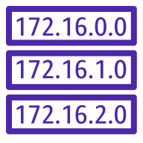

BLOCK Country1, Country 2
AWS Cloud
Patches
Updates
Code repos
SaaS
Anywhere
Internet
Anywhere
Standalone VPC with NAT Gateway
Standalone VPC with Aviatrix
IGW
IGW
NAT
NAT
FQDN Filtering
Threat Protection
Geo-Blocking
Visibility
EC2 Instances
EC2 Instances
NAT gateway
NAT gateway
Aviatrix Gateway
Aviatrix Gateway
Aviatrix
Controller
Cloud
Workloads
0.0.0.0/0 → IGW
0.0.0.0/0 → IGW
Public Subnets
Public Subnets
Aviatrix
CoPilot
Aviatrix
Secure Egress
Gateways
Route table
EC2 Instances
EC2 Instances
App 3
0.0.0.0/0 → NAT GW
0.0.0.0/0 → Aviatrix
App 2
Private Subnets
Private Subnets
AZ1
AZ2
AZ1
AZ2
App 1
ALLOW *.github.com, updates.ubuntu.com
EXCEPT gist.github.com
deny all

Slide 13
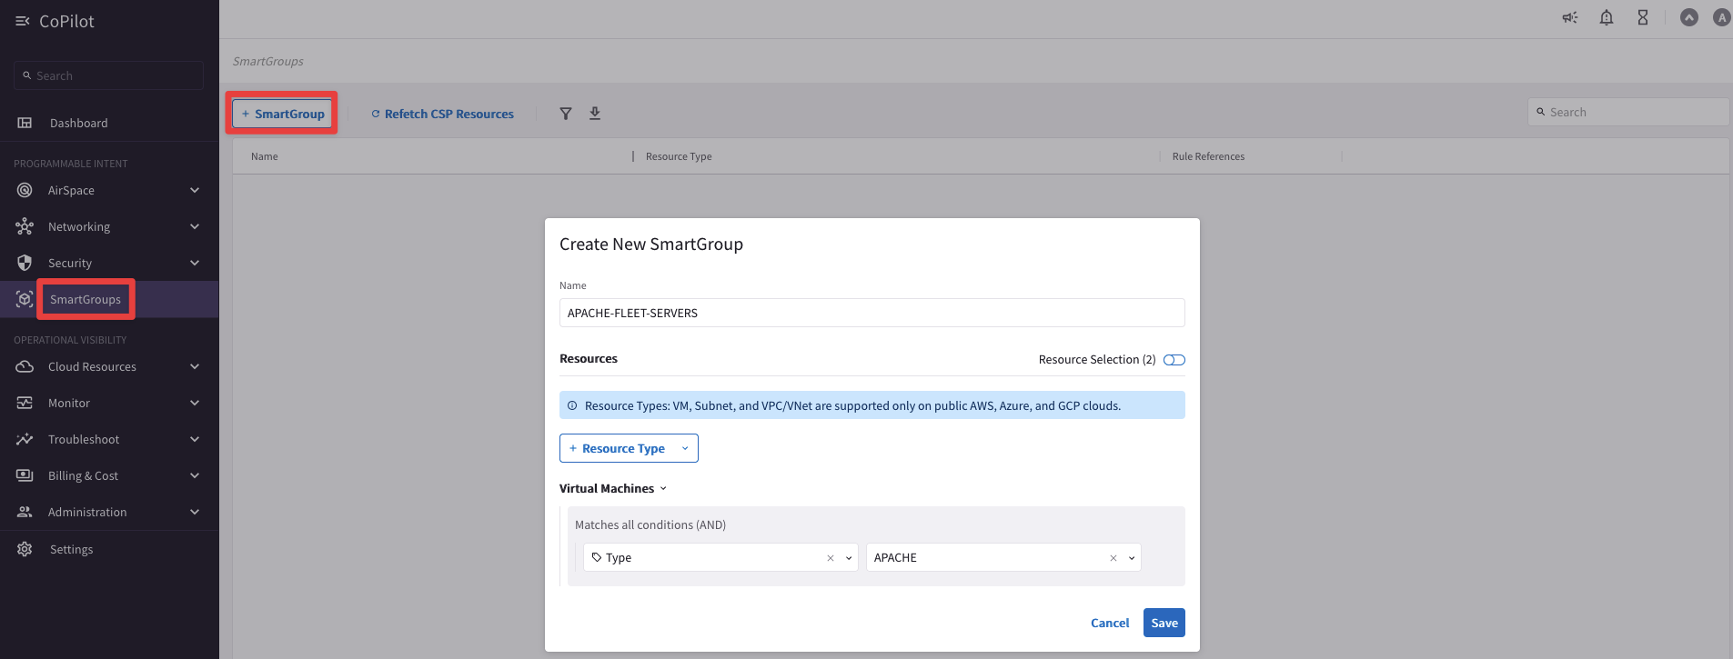

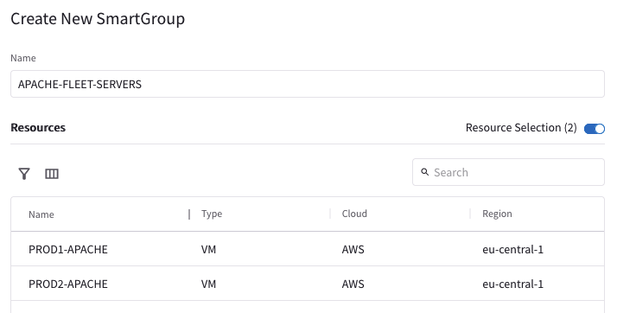
Smart Groups Creation
Controller polls the CSPs to retrieve inventory (about VPCs, instances etc.) every 15 minutes (can be modified)
CoPilot queries Controller every 1 hour (can be modified)
On-demand refresh of tags is available

Slide 14
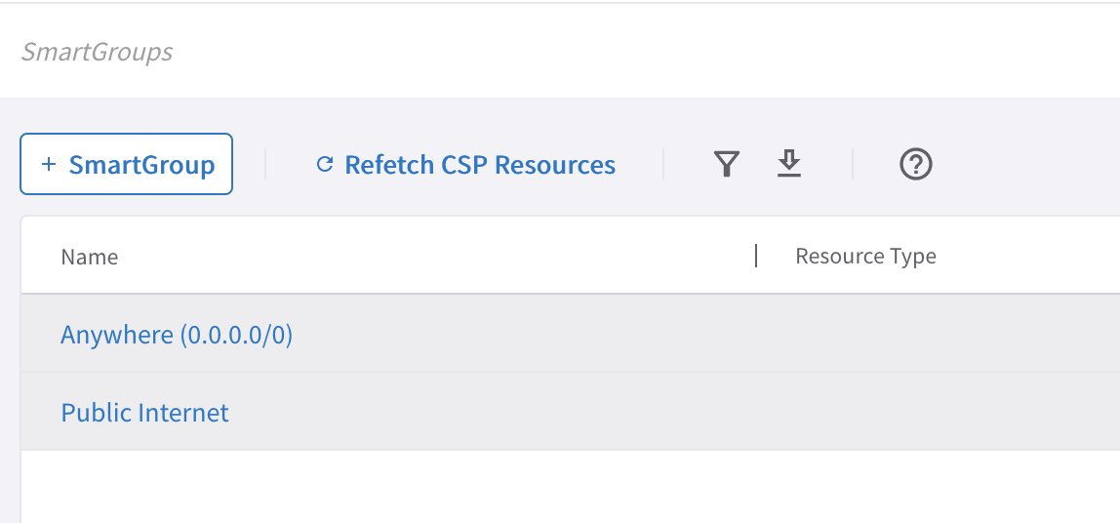
Pre-defined Smart Groups
Anywhere (0.0.0.0/0) → RFC1918 routes + Default Route (IGW)
Public Internet → Default Route (IGW)

